Slide 1





CorrelAid Switzerland
DataCross
CorrelAid.ch
DataCross.ch
@CorrelAidSwiss
@DataCrossCH
@CorrelAidSwiss
@DataCross-Switzerland
Notes:
Hi! My name is Freya and I would like to present to you our Swiss CorrelAid champter and DataCross. We are about 120 members in our Slack channel, although it is hard to count how many are actually active; at the moment, we are more enthusiastic Data Scientists than we have projects, and we also have 30 “core” members who also work on DataCross specifically.

Slide 2

Volunteer data work is invaluable in non-profit organizations
But continuity and maintenance is needed to ensure impact
Photo by Annie Spratt
Notes:
We believe that while volunteer data work is invaluable in non-profit organizations since they usually cannot afford the services, maintenance and continued deployment of data science solutions is crucial to achieve lasting impact
This takes time, requires oversight and continuity — which is difficult with sporadic volunteer work.

Slide 3

We provide data science services
with continuity and maintenance
to non-profits and NGOs
without sufficient funding
Photo by ThisisEngineering RAEng
Notes:
So DataCrosses aim is to provide Data Science services along with a focus on continuity and maintenance
We have a mission to provide services to non-profits and NGOs, who don’t have the resources to fund this work themselves

Slide 4

CorrelAid Switzerland vs. DataCross
All (data science) work on purely voluntary basis
Initial work on purely voluntary basis, but paid long-term maintenance
Notes:
goal: connect voluntary work in projects with the long-term maintenance. We suppose that very little maintenance can already achieve a lot and want to get enough funds to hire someone to do so.

Slide 5
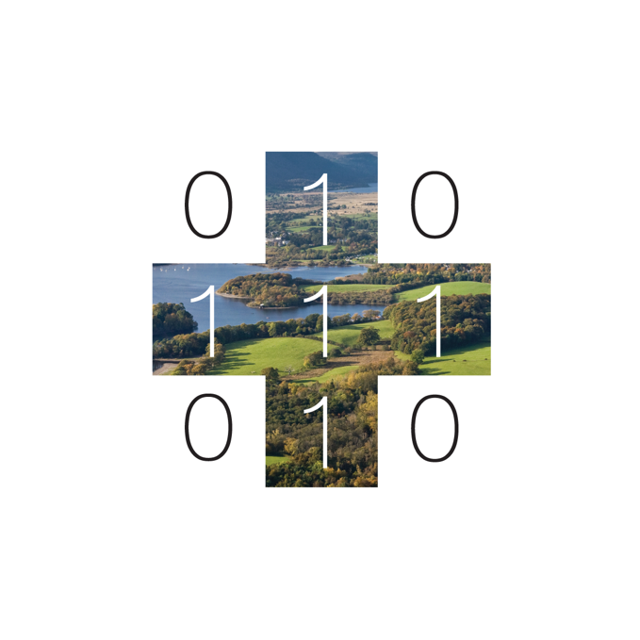




How?
Donors
Association
NGOs, orgs
Examples only
Notes:
Via DataCross, we aim to collect the funds needed and then apply them along with our expertise to the projects that need the Data Science services. However, wo do net yet have these funds and still need to build a portfolio, so this is rather our mission than current reality.

Slide 6

2021
Official foundation of DataCross
Two projects started
Application for tax-free status started
Hackathon on Swiss sustainability research @sdghackathon
Notes:
As of 2021, we managed to found DataCross officially as a Swiss association and are currently applying for the tax-free status, meaning that we would be recognized as a non-profit organization. In the beginning of November, we successfully worked together on a Hackathon on vizualizations on Swiss sustainability research, which you can find on Twitter. We also worked on two projects which I briefly want to showcase to you.

Slide 7


Action4Diabetics
Charity: provides free healthcare for Type-1 diabetic children in Asia
Analysis and visualisation of longitudinal health data
Baseline for monitoring impact
Notes:
Action for diabetics is a program that provides medical supplies and assistance to children and young adults with diabetes, and such help is extremely valuable as diabetes can be a very difficult medical condition to manage.
The aim of the project is to transfer medical data that has been collected on patients in clinics located in different Southeast Asian countries (e.g., Laos, Thailand, Vietnam) into a database that can offer more readily valuable insights for the NGO. Currently all the data is stored as excel sheets, so we are currently in the process on writing scripts that allow to extract this data, make it more machine readable and then transfer into the database.
Being able to track the progress and changes is key to the success and maintenance of the programs that Action for diabetics carries. We hope that with a database it makes it easier for the NGO to later identify key insights, figures and visualize this information in a meaningful way.

Slide 8

Price monitoring in Lebanon
Web dashboard tracking prices of standard goods in Lebanon
Inflation causes rapid fluctuation in prices
Dashboard will help NGO programmes adjust their support
Notes:
Lebanon has been suffering from hyperinflation, which disproportionately affects the most vulnerable in society. On a daily basis, migrants are particularly exposed to strong price fluctuations and the associated price speculation and potentially even fraud. The aim of the project was to build a dashboard to monitor the development and range of the prices of basic goods such as diapers or soap

Slide 9
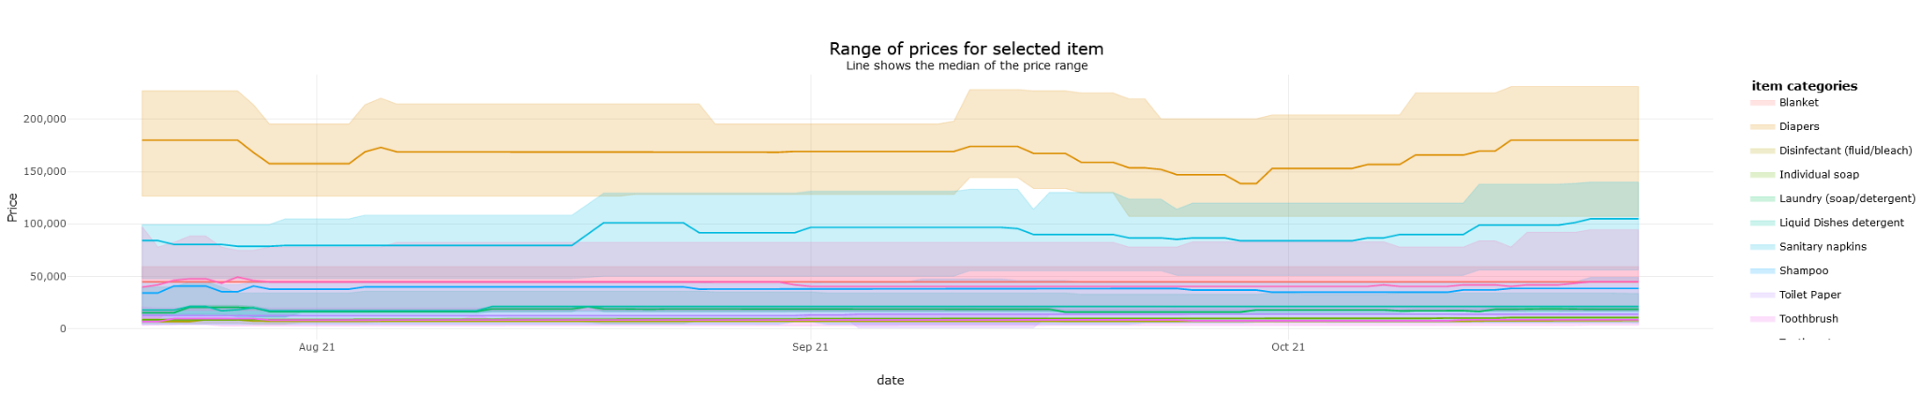
Web-based shiny App
https://bzlato.shinyapps.io/dashboard-range/
Notes:
You can see a screenshot of the app we developed here.
The data used has been collected from Spinneys and Carrefour Lebanon via daily web-scraping
Using the app, users can determine the price ranges and see if they are buying a product on the higher or lower end of the price range.
We believe that it will also be useful to the non-profit we work with and policy-makers as data baseline to work with.

Slide 10

What we need
New projects
People:
Marketing
Event planning
Presenters for meetup events
Notes:
We would love to help more associations and are currently searching for new projects, so any interested NGO’s are welcome to contact us!
Other than that, we would love to hear from you if you want to join us. Currently, we especially need one person each to help with marketing and social media as well as event planning. In addition to that, we would love to spread the word more and have more events via the meetup platform, which we need future presenters for to share our vision.

Slide 11
CorrelAid Switzerland
DataCross
CorrelAid.ch
DataCross.ch
@CorrelAidSwiss
@DataCrossCH
@CorrelAidSwiss
@DataCross-Switzerland

